Slide 1

Making this resource work for you
Prior to teaching this lesson, please refer to the ‘Unit Overview and Planning Document’.
Further guidance on planning Science Mastery lessons can be found in the detailed planning guidance document.
Refer to the ‘notes’ section on each slide for useful information, including suggested expositions, pedagogical content knowledge, suggested questions, answers and more. Consider using presenter mode so you can see this guidance throughout the lesson.
The introduction slides can be adapted to suit your teaching style and the needs of your class.
Before the lesson, adapt the fix-it slide to address any misconceptions identified in the previous lesson’s exit ticket.
Choose from the suggested activities to suit your class. The intention is not that you complete all of these, but that you select those which ones are most appropriate for your students. It may be appropriate to further adapt activities for your students.
These lessons are designed to occupy approximately 1 hour. To adapt for a shorter or longer lesson duration we advise you to adapt the activity section accordingly.
Please consider using the final slide to send feedback about this lesson or examples of PowerPoints that you have adapted to our design team. Your feedback is used to improve Science Mastery for all of our teachers and students. We appreciate all suggestions and comments.
Thank you for reading!
The Science Mastery Team

Slide 2

Acceleration
Answer the following questions:
State Newton’s First Law.
State Newton’s Third Law.
Define velocity.
Describe what happens to a stationary object if it is acted upon by an unbalanced force.
Describe the possible motion of an object with balanced forces acting on it.
An object’s motion will not change unless acted upon by an unbalanced force.
Every action has an equal and opposite reaction. If object A exerts a force on object B, B exerts an equal and opposite force on A.
Velocity is the speed of an object in a given direction.
The object will accelerate in the direction of the resultant force.
The object would be stationary or travelling at a constant speed in the same direction.
Notes:
Foundation question: State the SI unit for velocity.
Answer: SI unit for velocity is m/s.
Stretch question: Explain the difference between speed and velocity and when you would use them.
Answer: Speed is how far an object travels in a given time, velocity is speed in a given direction. Speed would be used when referring to distance travelled, velocity would be used when referring to displacement.

Slide 3
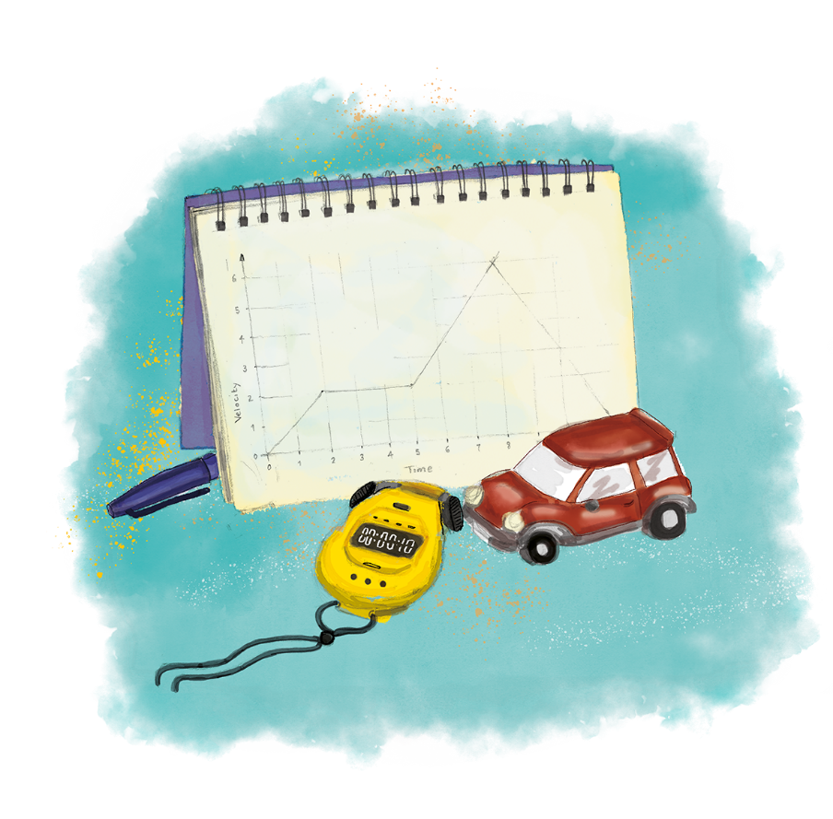


P3.1.7
03/12/2024
Acceleration
P3.1.1 Prior Knowledge Review
P3.1.2 Scalars and Vectors
P3.1.3 Resultant Vectors
P3.1.4 Resolving Vectors
P3.1.5 Newton's Third Law
P3.1.6 Newton's First Law
P3.1.7 Acceleration
P3.1.8 Acceleration Investigation
Maths in Science Lesson 17
P3.1.9 Velocity-Time Graphs
P3.1.10 Velocity-Time Graphs 2
P3.1.11 Acceleration Problems
Notes:
Students should know from P2.1 that acceleration is a measure of how quickly speed or direction is changing. In this lesson they will look at that in more detail, including the calculation and investigate it in the next lesson.

Slide 4

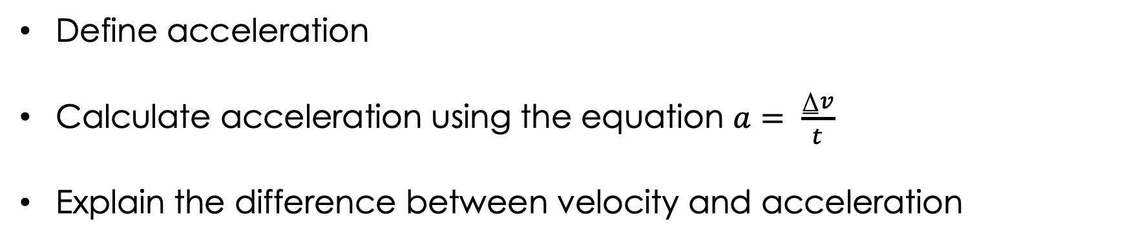
Following this lesson, students will be able to:
Define acceleration
Calculate acceleration using the equation $a= \frac{⍙v}{t}$
Explain the difference between velocity and acceleration
Key Words:
acceleration
deceleration
velocity
initial
final

Slide 5
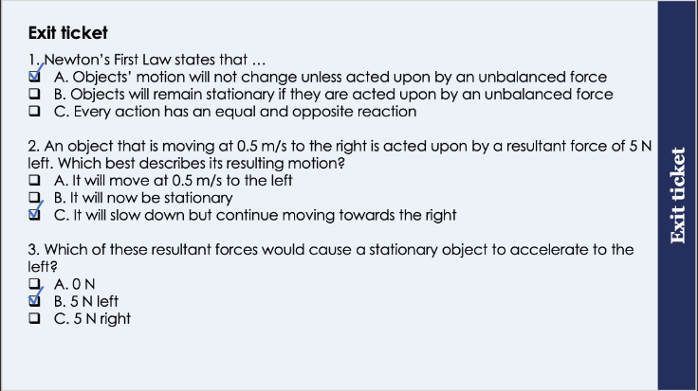
This is the fix-it portion of the lesson
The fix-it is an opportunity to respond to gaps in knowledge, especially those identified by the previous lesson’s exit ticket.
The teacher should customise this slide as needed, to facilitate
reteach, explanation, demonstration or modelling of ideas and concepts that students have not yet grasped or have misunderstood.
practise answering specific questions or of key skills.
redrafting or improving previous work.
Notes:
Suggested Guidance from previous exit ticket:
Q1. Answer: A
If pupils answered B or C they need to be clearer on the exact definition of Newton’s First Law. To fix-it, It may be useful to refer back to the knowledge organiser to highlight Newton’s Laws or rephrase the laws and get pupils to determine which is which.
Q2. Answer: C
If students answered A they have understood that the acceleration now acts towards the left but not applied that to an object that is already acting left. If students answered B they may assume that any force acting in the opposite direction automatically stops the current motion. To fix-it it may be useful to show more real life examples of Newton’s First Law. A good example to use is with a car because all pupils will have experienced a car accelerating and decelerating. It may be useful to get pupils to draw force diagrams of driving force (thrust) vs brakes:
Car is stationary when there is no driving force or break → balanced forces
Car accelerates forwards when accelerator/thrust is applied – resultant force is forwards because thrust is greater than braking force.
Car slows down when brakes are applied – it does not start moving backwards! The resultant force is acting backwards but it slows the car down rather than changing its direction.
Q3. Answer: B
If students answered A or C they have not been able to apply Newton’s First Law. To fix-it, it may be useful to provide further scenarios where objects are either stationary or already moving with different resultant forces acting on them.

Slide 6
General Definition
Scientific Definition
An increase in speed or rate.
From the Latin accelerare meaning ‘hasten’.
The rate of change of velocity.
Acceleration
‘In an age of acceleration, nothing can be more exhilarating than going slow. And in an age of distraction, nothing is so luxurious as paying attention. ’
Pico Iyer
Synonyms
General Examples
Speed up
Quicken
The acceleration of technology has already been a big feature of the 21st century.
Scientific Examples
The car had a negative acceleration as it slowed down at traffic lights.
Notes:
Purpose of this slide:
The purpose of the Frayer organiser is to address key scientific vocabulary that students may be familiar with from a non-scientific context. Addressing this at the beginning of the lesson limits the potential cognitive conflict that might arise if students are using their current non-scientific interpretation of a term to understand the science being learned. This approach limits the potential for misconceptions and confusion arising from differing scientific and non-scientific uses of the same word.
The use of this slide is intended to clearly show students
how a word can have both scientific and non-scientific meanings simultaneously
the correct usage of a word in both a scientific and non-scientific context
Teacher guidance:
This slide should be used briefly. Do not dwell on each portion of the slide as this can eat into the lesson quite quickly.
This might be an apt opportunity to ask students to write the scientific definition of the key term into their books. Alternatively, you may want to wait to do this until the term is addressed in more depth later in the lesson.
Suggested narration:
Here we have the word ‘X’. You many already be familiar with this word [display general examples and general definition] in this context. Well, in science, we use this term slightly differently. [display scientific example]. [Display scientific definition]. In science when we use this word what we actually mean is this. You can see that words which mean the same include X,Y and Z. Words that mean the opposite include A, B an C. From this point in the lesson when we refer to this word we’ll be using it in the scientific sense.

Slide 7
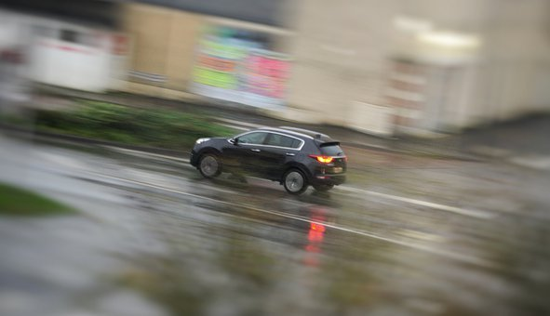
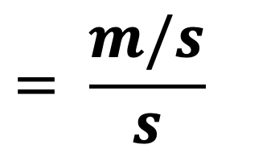
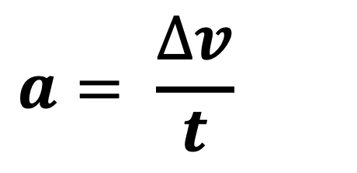
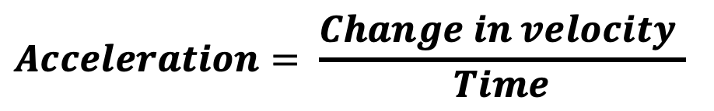
Acceleration
Acceleration is the rate of change of velocity.
$$Acceleration= \frac{Change in velocity }{Time}$$
This could be an object speeding up, slowing down or changing direction.
Change in velocity is the final velocity minus the initial velocity.
The SI unit for acceleration is metres per second squared (m/s²).
As acceleration is the rate of change of velocity, it is also a vector quantity.
$$a= \frac{∆v}{t}$$
$$= \frac{m/s}{s}$$
Notes:
Exposition type: explanation
Suggested exposition:
If you think of the word acceleration, chances are you likely think of the acceleration of a car or of a sprinter and it always means that they are getting faster. This is not quite true. Acceleration is the rate of change of velocity, so a measure of how quickly velocity changes.
What is velocity?
Speed in a given direction.
Notice that acceleration refers to a rate of change of velocity, not a rate of increase. This is because acceleration can refer to an object speeding up (getting faster), slowing down (getting slower) or changing direction. Changing direction is an example of acceleration because if the direction changes then the velocity changes, and acceleration is the rate of change of velocity.
Acceleration is the rate of change of velocity so we can use this definition to help us calculate it, as it is simply how quickly the velocity of an object changes. This means that we need to know how much the velocity changed by and how long this took.
The equation to calculate acceleration is the change in velocity/time. Change in velocity is simply the new velocity (called final velocity) minus the starting velocity (called initial velocity).
What are the SI units for velocity?
Metres per second (m/s).
What are the SI units for time?
Seconds (s)
As we are looking at the rate of change of velocity, this is metres per second divided by seconds, which gives us metres per second per second. We say this as metres per second squared m/s² and this is the SI unit for acceleration.
Note: Pupils are not given this equation so they need to remember it as rate of change of velocity (change in velocity over time).
Image source: pixabay

Slide 8
I: Calculating Acceleration
Worked example:
Calculate the acceleration of a car that goes from rest to 10 m/s forwards in 5 seconds.
Acceleration = change in velocity
time
a = 10 m/s – 0 m/s
5 s
a = 2 m/s² forwards
$$a= \frac{∆v}{t}$$
Notes:
Exposition type: explanation
Suggested exposition:
Now we can look at a worked example of how to calculate acceleration.
Calculate the acceleration of a car that goes from rest to 10 m/s in 5 seconds. Remember that acceleration is the rate of change of velocity, so how quickly the velocity changes. We can use the equation acceleration = change in velocity/time.
Let’s identify the quantities that we need for the equation:
Acceleration:? This is what we are calculating
Change in velocity: to calculate the change in velocity we need to know the final and initial velocities.
What is the final velocity? (The velocity that the car ended up with)
10 m/s
What is the initial velocity? (The velocity that the car started with)
It started from rest, so the initial velocity was 0 m/s.
How long did this take?
5 seconds
Once we substitute these values into the equation we can solve it for acceleration. This gives us an answer of 2 and the unit for acceleration is 2 m/s². Remember that velocity is a vector, in this case the final velocity was 10 m/s forwards, so acceleration is also a vector. This means that our final answer for acceleration also needs to have a direction, which in this case will be forwards.

Slide 9
Acceleration
Acceleration can refer to speeding up, slowing down or changing direction.
A negative acceleration (an object slowing down) can be called deceleration.
An object travelling in a circle is accelerating because it is constantly changing direction.
Objects near the surface of the Earth experience acceleration due to gravity of 9.8 m/s².
As objects speed up, air resistance increases.
Notes:
Exposition type: Explanation
Suggested exposition:
Acceleration can refer to speeding up, slowing down or changing direction, as all of these include a change in velocity. A negative acceleration is still acceleration but it can also be described as deceleration.
An object travelling in a circle is also an example of acceleration, as the velocity is constantly changing as the direction changes. An object travelling in a circle is always accelerating towards the centre of the circle, for example the Moon and the ISS are constantly accelerating towards the centre of the Earth as they orbit around it.
Objects that are near the surface of Earth experience acceleration because of gravity at 9.8 m/s². Notice that when we calculate weight we use this number (rounded to 10) to calculate the weight of an object because of the gravitational field, which is a measure of how quickly objects accelerate towards another body. This means that objects in this field will accelerate at 9.8 m/s².
If we think about a positive acceleration, so an object speeding up, the air resistance acting on it also increases. It’s easy to think about this if you compare cycling slowly and cycling very quickly, you can feel how different the air resistance is. Eventually objects accelerate and get to a high enough speed where they have built up as much air resistance as pushing/thrust force and the forces balance out. As the forces are now balanced, the object remains in its constant state of motion (remember Newton’s First Law) and it will continue moving at a constant velocity. This maximum possible speed (with direction) is called terminal velocity and we will come back to look at it in more detail in a later lesson).
Notes:
Depending on ability of class you may want to focus more on the effect of speed on air resistance and link this with terminal velocity – a good/relatable example to use is the top speeds of cars – why can’t they just get faster exponentially? Their air resistance increases as they get faster so they reach a point where their thrust force is equal to air resistance and this is their terminal velocity. You may also want to mention streamlining objects to decrease their air resistance and therefore increase their possible terminal velocity.

Slide 10
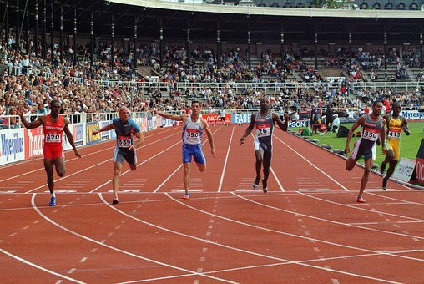
We: Calculating Acceleration
Worked example:
Calculate the acceleration of a sprinter that crosses the finish line and slows down to a stop from 10 m/s in 2 seconds.
Acceleration = change in velocity
time
a = 0 m/s – 10 m/s
2 s
a = - 5 m/s²
$$a= \frac{∆v}{t}$$
Notes:
Exposition type: explanation
Suggested exposition:
We can also calculate the acceleration of an object that is slowing down.
Acceleration is change in velocity/time so let’s identify our quantities again.
Acceleration:?
Final velocity: slows down to a stop, 0 m/s
Initial velocity: 10 m/s
Time: 2 s
This time we have a negative change in velocity because the initial velocity is greater than the final velocity. This gives us a negative value for acceleration, which we can also describe as a deceleration. We can leave our answer as - 5 m/s² as the minus sign shows that it is acting in the opposite direction. We can leave our answer like this, or we can write it as 5 m/s² backwards/in the opposite direction. Note that this does not mean the object/person is actually travelling backwards, this is just the direction of the acceleration.
Image source: pixabay

Slide 11
You: Calculating Acceleration
Worked example:
Calculate the acceleration of a cyclist that speeds up from 6 m/s to 10 m/s over 5 seconds.
Acceleration = change in velocity
time
a = 10 m/s – 6 m/s
5 s
a = 0.8 m/s²

Slide 12
Determine if the following statements are true or false:
Acceleration is an increase in velocity
An object moving in a circle is accelerating
The SI unit for acceleration is m/s
Acceleration can be calculated by dividing the change in velocity by time
If an object starts at rest its final velocity is 0 m/s
An object that is accelerating must have balanced forces acting upon it
As an object speeds up, the air resistance acting on it increases
False
True
False
True
False
False
True
Notes:
Purpose: review of new information.
Give thinking time and 3,2,1 to minimise copying. Use questioning to explain why statements are false and correct false statements.
False - it is a change in velocity – increase/decrease or change in direction
True
False – SI unit is m/s²
True
False – its initial velocity is 0 m/s, its final velocity is the speed that it reaches after accelerating.
False - acceleration is a change in motion and only an unbalanced force can change the motion of an object.
True

Slide 13

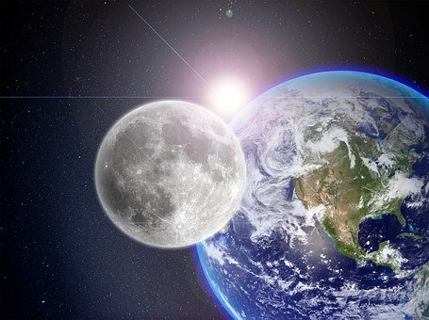



Which statements do you agree with?
I think that the Moon is accelerating because it is always getting faster
I think the Moon is not accelerating because it is moving at a steady speed
I think that the Moon is not accelerating because it always travels in the same direction
I think that the Moon is accelerating because it is constantly changing direction
Notes:
Guidance: this is one of the trickiest parts for pupils to get their heads around and can generate several misconceptions.
Blue: incorrect. An object moving in a circle is accelerating because it is constantly changing velocity as it changes direction (accelerates towards the centre of the Earth).
Yellow: incorrect. The Moon is accelerating because it is constantly changing velocity as it changes direction (accelerates towards the centre of the Earth), but it is because it is changing direction rather than its speed changing.
Green: correct
Pink: incorrect. An object moving in a circle is constantly changing direction, so it is accelerating as its velocity is changing.
Suggested guidance:
Talk tasks can be used in a variety of ways to suit the particular needs of the students you are teaching. Through exchanging views with others, students develop their understanding of the science beyond what could be achieved individually.
Science classrooms that successfully integrate talk have the following features:
Science talk is a regular feature of lessons and is woven into classroom activities.
Students are paired or grouped strategically by the teacher to ensure productive interaction. This might take into consideration the students’ proficiency of the English language, how encouraging they might be to peers and their attainment in the topic. It’s a good idea to consider these pairings in the class seating plan.
Students are encouraged and supported to talk, but are not forced to talk.
The teacher should take on the role of a facilitator, engaging with conversations where necessary and encouraging or steering the conversation where needed.
Students are encouraged to use the language they have to express their ideas (e.g., everyday language, imperfect English, native language), but also to incorporate science specific terminology where this is more accurate or has been taught.
6. Scientifically inaccurate ideas are not dismissed by the partner or teacher; open discussion and further investigation are relied on to help students construct ideas that support them to progress in their scientific understanding.
7. Guidelines for behaviour during talk tasks are explicit and frequently reviewed. Rules for students might be:
Listen carefully to your partner
Take turns talking.
Speak one at a time, without interrupting.
Politely agree or disagree and explain why.
Politely point out if your partner has used a scientific word incorrectly, if they have explained the science incorrectly, or if there is a more accurate way to describe something.
If confused, ask questions.
Stay focused on the discussion topic.
Respond to one another.
Image source: pixabay

Slide 14
Drill
What is velocity?
What are the SI units for velocity?
What is acceleration?
What does the symbol ∆ mean?
What are the SI units for acceleration?
What is the equation used to calculate acceleration?
When an object is decelerating what is it doing? When calculating deceleration, it must always be a…... number. What is the value for acceleration due to gravity? Give units. As an object speeds up what happens to its air resistance? An object at rest has a velocity of...?
Notes:
Purpose: This is a knowledge drill. The purpose of this is to check that the critical knowledge is secure before pupils move onto independent practice.
Suggested guidance: There are a range of ways this could be done depending on time and ability range of the class:
Mini whiteboards
As full sentences in exercise books
As short answers in exercise books
In the pupil workbook
As pair talk
As cold call

Slide 15
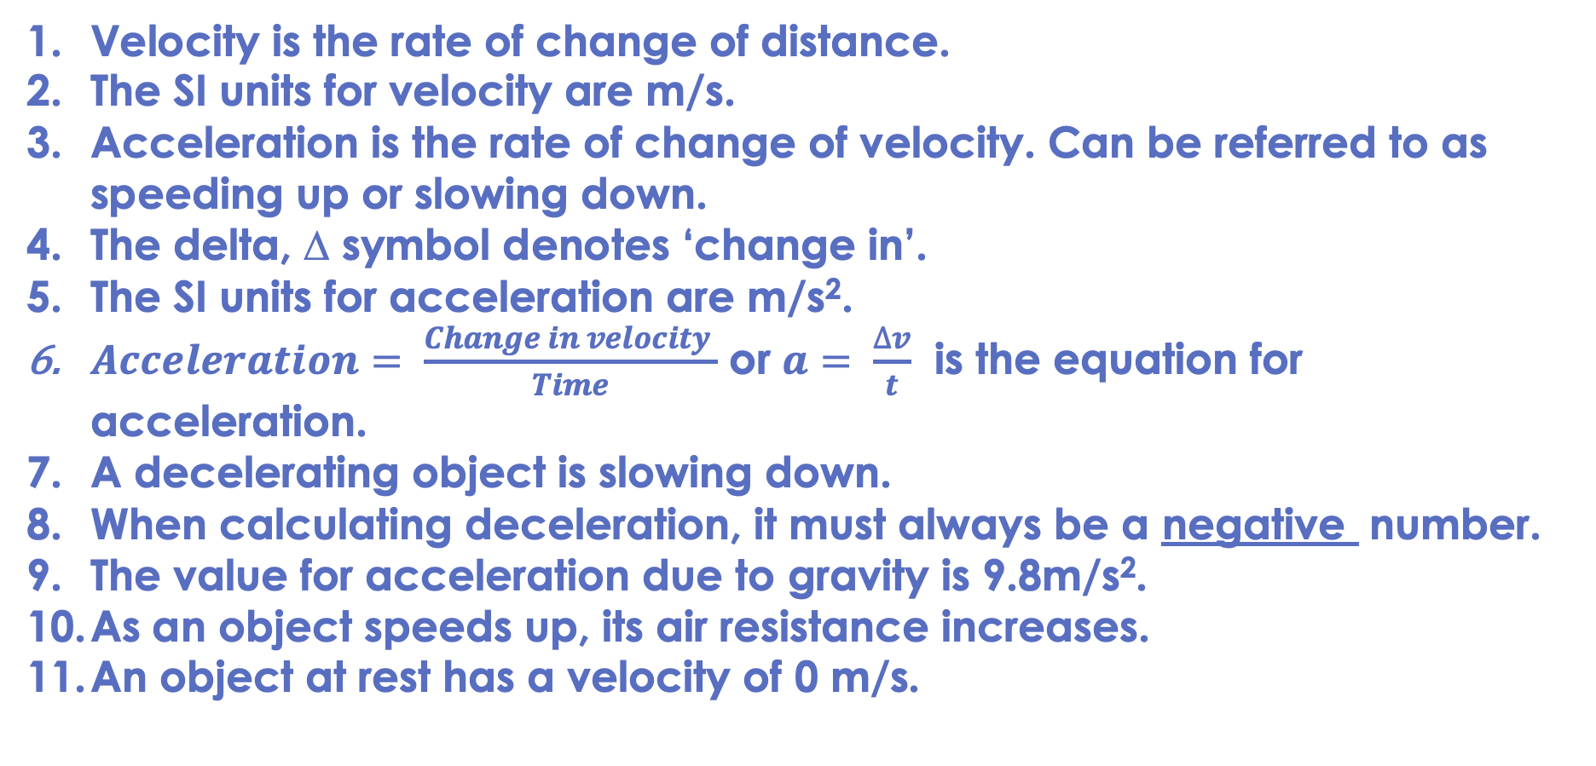
Drill answers
Velocity is the rate of change of distance.
The SI units for velocity are m/s.
Acceleration is the rate of change of velocity. Can be referred to as speeding up or slowing down.
The delta, ∆ symbol denotes ‘change in’.
The SI units for acceleration are m/s².
$Acceleration= \frac{Change in velocity }{Time}$ or $a= \frac{∆v}{t}$ is the equation for acceleration.
A decelerating object is slowing down.
When calculating deceleration, it must always be a negative number.
The value for acceleration due to gravity is 9.8m/s².
As an object speeds up, its air resistance increases.
An object at rest has a velocity of 0 m/s.
Notes:
Purpose: This is a knowledge drill. The purpose of this is to check that the critical knowledge is secure before pupils move onto independent practice.
Suggested guidance: There are a range of ways this could be done depending on time and ability range of the class:
Mini whiteboards
As full sentences in exercise books
As short answers in exercise books
In the pupil workbook
As pair talk
As cold call

Slide 16

How many links can you make between acceleration and forces?
What is acceleration?
What are balanced and unbalanced forces?
What is Newton’s First Law?
Notes:
Opportunity for pupils to consolidate learning about forces and acceleration. You may want to get pupils to think, pair, share and choose their links.
Listed questions are for guidance - you may want to change/add different prompts for your class.
Suggested points:
Only an unbalanced force can change the motion of an object
Acceleration is a change in motion
Acceleration = rate of change of velocity
Positive acceleration is speeding up
Negative acceleration is slowing down
Acceleration can also be a change in direction
All are a change of velocity caused by an unbalanced force
Forces are balanced when an object is stationary
Forces become unbalanced which causes acceleration
Object accelerates in the direction of the resultant force
Suggested guidance:
Talk tasks can be used in a variety of ways to suit the particular needs of the students you are teaching. Through exchanging views with others, students develop their understanding of the science beyond what could be achieved individually.
Science classrooms that successfully integrate talk have the following features:
Science talk is a regular feature of lessons and is woven into classroom activities.
Students are paired or grouped strategically by the teacher to ensure productive interaction. This might take into consideration the students’ proficiency of the English language, how encouraging they might be to peers and their attainment in the topic. It’s a good idea to consider these pairings in the class seating plan.
Students are encouraged and supported to talk, but are not forced to talk.
The teacher should take on the role of a facilitator, engaging with conversations where necessary and encouraging or steering the conversation where needed.
Students are encouraged to use the language they have to express their ideas (e.g., everyday language, imperfect English, native language), but also to incorporate science specific terminology where this is more accurate or has been taught.
6. Scientifically inaccurate ideas are not dismissed by the partner or teacher; open discussion and further investigation are relied on to help students construct ideas that support them to progress in their scientific understanding.
7. Guidelines for behaviour during talk tasks are explicit and frequently reviewed. Rules for students might be:
Listen carefully to your partner
Take turns talking.
Speak one at a time, without interrupting.
Politely agree or disagree and explain why.
Politely point out if your partner has used a scientific word incorrectly, if they have explained the science incorrectly, or if there is a more accurate way to describe something.
If confused, ask questions.
Stay focused on the discussion topic.
Respond to one another.

Slide 17

Compare: to outline the similarities and/or differences between things
Example question:
Compare the forces acting on an object that is accelerating and an object that is travelling at constant velocity.
To ‘compare’, your answer should:
Give similarities.
Write paired statements that show differences relating to the same feature.
Use the term ‘whereas’ to link your statements.
Model answer:
Both objects can have forces acting on them in opposite directions
An object that is accelerating must have an unbalanced force acting on it, whereas an object that is travelling at constant velocity must have balanced forces acting on it
Balanced forces are equal in magnitude and opposite in direction, whereas unbalanced forces may be opposite in direction but not equal in magnitude

Slide 18
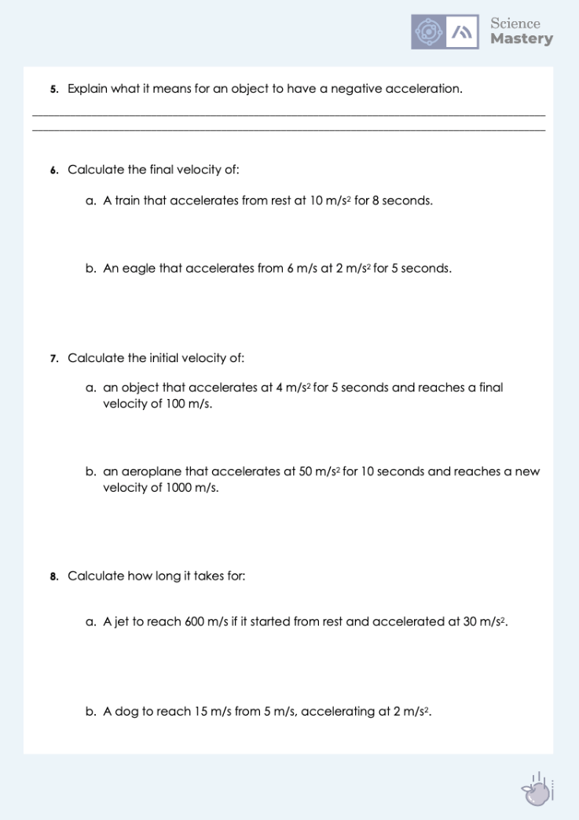
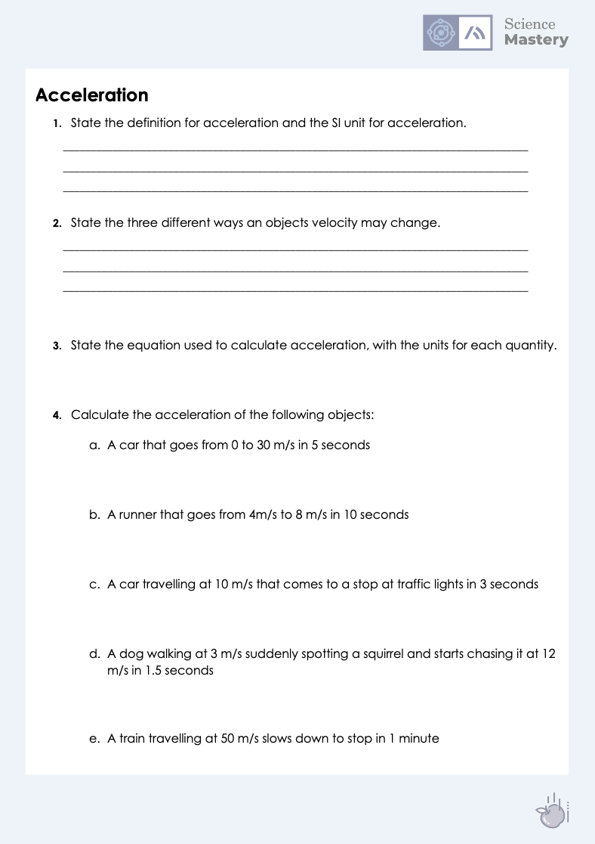
Acceleration
Complete the worksheet on acceleration.
Show clear working, including the equation you use.
Remember to include units and direction where necessary.
Notes:
Purpose: practice application of new knowledge.
Markscheme provided to self/peer assess answers. Depending on the ability of your class, you may want to model how to rearrange the equation. It is better to substitute values into the equation in the given format (substitution marks are given), then if any mistakes are made during the calculation pupils at least get credit for the substitution. If they rearrange incorrectly and then substitute no marks are awarded.
Stretch – ask pupils to write their own scenarios as questions for others.
You may want to use actual directions if pupils would find that easier to answer. Negative values for acceleration will be covered further in the velocity-time graph lessons but you may want to introduce the idea about negative velocity being in the opposite direction and negative acceleration referring to either deceleration or acceleration in the opposite direction.

Slide 19
Answers
1. Acceleration is the rate of change in velocity, measured in m/s²
2.
Speed up
Slow down
Change direction
3. a = Δ v
t

Slide 20
Answers
4a. a = Δ v
t
a = 30 m/s – 0 m/s
5
a = 6 m/s² (forwards/in direction of motion)
4b. a = Δ v
t
a = 8 m/s – 4 m/s
10
a = 0.4 m/s² (forwards/in direction of motion)
4c. a = Δ v
t
a = 0 m/s – 10 m/s
3
a = -3.33 m/s² (forwards/in direction of motion)
or 3.33 m/s² backwards (this means the direction of acceleration is backwards but it does not mean the car is moving backwards)

Slide 21
Answers
4d. a = Δ v
t
a = 12 m/s – 3 m/s
1.5
a = 6 m/s² (forwards/in direction of motion)
4e. a = Δ v
t
a = 0 m/s – 50 m/s
60
a = -0.83 m/s² (forwards/in direction of motion)
or 0.83 m/s² backwards/in the opposite direction

Slide 22
Answers
5. That the object is slowing down.
6a. a = Δ v
t
10 m/s² = final velocity – 0 m/s
8 s
80 = final velocity – 0
Final velocity = 80 m/s
6b.a = Δ v
t
2 m/s² = final velocity – 6 m/s
5 s
10 = final velocity – 6
Final velocity = 16 m/s

Slide 23
Answers
7a. a = Δ v
t
4 m/s² = 100 – initial velocity
5 s
20 = 100 – initial velocity
Final velocity = 80 m/s
7b. a = Δ v
t
50 m/s² = 1000 – initial velocity
10 s
500 = 1000 – initial velocity
Final velocity = 500 m/s

Slide 24
Answers
8a. a = Δ v
t
30 m/s² = 600 m/s – 0 m/s
time
30 t = 600
t = 20 seconds
8b. a = Δ v
t
2 m/s² = 15 m/s – 5 m/s
time
2 t = 10
t = 5 seconds

Slide 25
Answer the questions below.
1. Acceleration is …
A. The rate of change of velocity
B. When an object gets faster
C. An increase in velocity
2. Which of these is an example of acceleration?
A. A car coming to a stop at traffic lights
B. A car driving over the speed limit at 20 m/s
C. Two trains passing each other at different speeds
3. What is the acceleration of a sprinter going from rest to 10 m/s in 2 seconds?
A. 5 m/s
B. 5 m/s²
C. - 5 m/s²
✓
✓
✓
Notes:
Suggested Guidance:
Q1. Answer: A
If students answered B or C, they have the common misconception that acceleration only refers to an increase in speed or velocity. To fix-it, it may be useful to give pupils further scenarios of objects slowing down or changing direction as examples of acceleration.
Q2. Answer: A
If students answered B, they have confused speed and acceleration. If students answered C, they have confused the idea of acceleration with relative motion. To fix-it, it may be useful to revisit the changing speeds lesson from P2.1 where pupils identify whether objects are changing speed or not.
Q3. Answer: B
If students answered A, they have correctly calculated acceleration but have chosen the wrong unit. If students answered C, they have taken their initial and final velocities incorrectly. To fix-it, practice further examples of acceleration calculations, with both positive and negative accelerations.

Slide 26
Lesson P3.1.7
What was good about this lesson? | What can we do to improve this lesson?
Send us your feedback by clicking this link
or by emailing sciencemastery@arkonline.org
Thank you!

